Slide 1

Exploring the training of text sentiment analysis models
Does a sentiment analysis model that was trained with data from a really broad context (random tweets) has a better ability to generalize than a model that was trained with data from a certain context (reviews)?
Presentation and Research by: Romario Quispe Huaman,José Higuera, Alex Weber, Joschua Sünneke,

Slide 2
Contents
Basic Information about Sentiment Analysis
Research Goal
How we conducted our Analysis
Accuracy of the Models on our test sets
What could explain the accuracy differences of the models (1)
What could explain the accuracy differences of the models (2)
Conclusions of the findings
Recommendations for training a model

Slide 3
Basic Information about Sentiment Analysis
What is sentiment analysis?
Process of natural language processing, text analysis and statistics to analyse the sentiment of text into categories like for example: negative, positive and neutral (1)
Process of sentiment analysis:
There are various ways to analyse text and program models that can take in text and give an estimate of the sentiment, but the overall process can be reduced to these steps:
1. Search for a Data Set
2. Data preparation (cleaning the data set, splitting the data set into training and test set)
3. Train the model (fitting various models to the training set)
4. Predict unseen Data (the trained models take in unseen data and gives an estimate of the sentiment)
5. Evaluate the Accuracy (controlling the accuracy of the predictions)
(1) https://www.datarobot.com/blog/introduction-to-sentiment-analysis-what-is-sentiment-analysis/

Slide 4


Research Goal
The ability of a model to generalize describes the ability to accurately estimate unseen data. In the process of training the model, the model gets to analyse data which already contains the right target variable (in our case positive or negative sentiment) by this the model “learns” what words are likely indicate a negative or positive sentiment.
One problem that can arise is that the data set used to train the model is too different from the unseen test data set so the model can’t accurately give an estimate of the sentiment, because it’s prior training is useless.
identifying factors that influence the ability to generalise

Slide 5
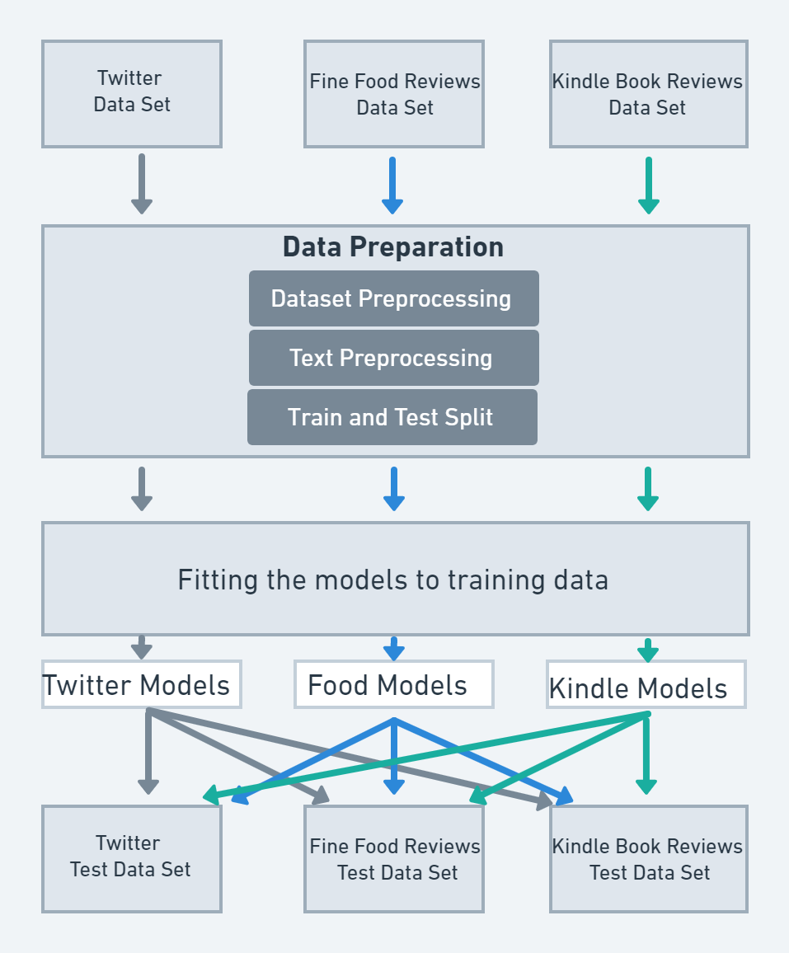
How we conducted our Analysis Used Data Sets and Analysis Models
Used Data Sets: different sizes and topics
All Data Sets were prepared with the same process:
in this step we deleted unnecessary data
Here we deleted unnecessary words that have no impact on context (removal of Stopwords)
Train and Test Split shuffles the whole data set and splits into two parts on for training the model and for testing it
Here 3 Sets of the following models were trained by one of the training data set. One set of models:
Logistic Regression
Decision Tree Classifier
Random Forest Classifier
Gradient Boosting Classifier
Long short-term memory recurrent neural Network (LSTM)
In the last step all Models predicted the sentiment on their own and on the other test data set and were evaluated on the accuracy

Slide 6
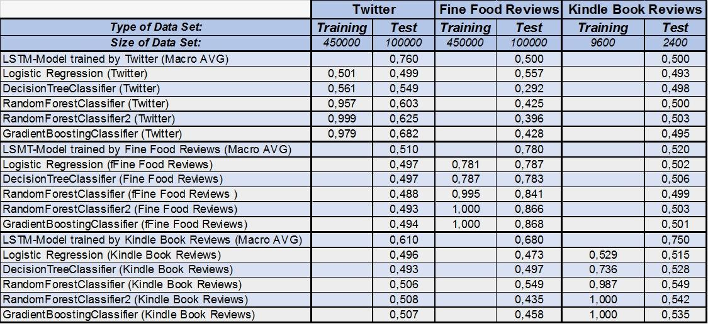
Accuracy of the Models on our test sets Striking occurrences in the results
Accuracy of all Models on Training and Test Data Sets:
The table contains all models trained by the three different data set and their respective accuracy on the test data sets
Striking occurrences:
all models except the LSTM-Models perform relatively bad on unseen test data sets (accuracy ≤ 50%)
Overall models performed better on the test sets of their own training sets
On average the LSTM-Models perform the best on unseen test data sets with the scores being slightly higher than the other models
Most striking is the ability of the LSTM-Model trained by the Kindle Book Review Data Set to predict unseen Test Data Sets, although it has the overall smallest Training Data Set

Slide 7
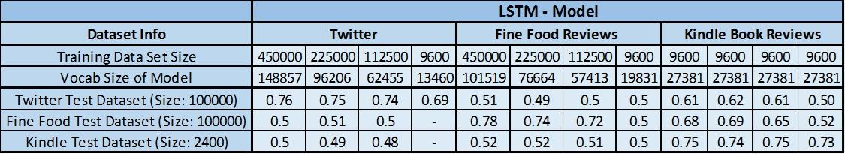
What could explain the accuracy differences of the LSTM-Models (1) Exploring the data sets and models
Since the LSTM-Models performed the best overall we decided to limit the following analysis to the LSTM-Models and examine the accuracy and vocabulary size with changing training data set size
Distinctive aspects:
The LSTM-Model trained by the Twitter data set couldn’t predict unseen test data sets, when it was trained with the same training data set size as the Kindle LSTM-Model
Noticeable is the Vocab Size difference in the Models with changing training data set size (for example the Twitter Model trained with Training Set size of 9600: 13460, whereas the Kindle Model: 27381)
For the Twitter and Fine Food LSTM-Model the accuracy tends to decrease with the reduction of the training data set size, but was still inferior to the Kindle Model when predicting unseen test data even with far bigger training data sets
Accuracy of LSTM-Models trained by smaller Training Data Sets

Slide 8
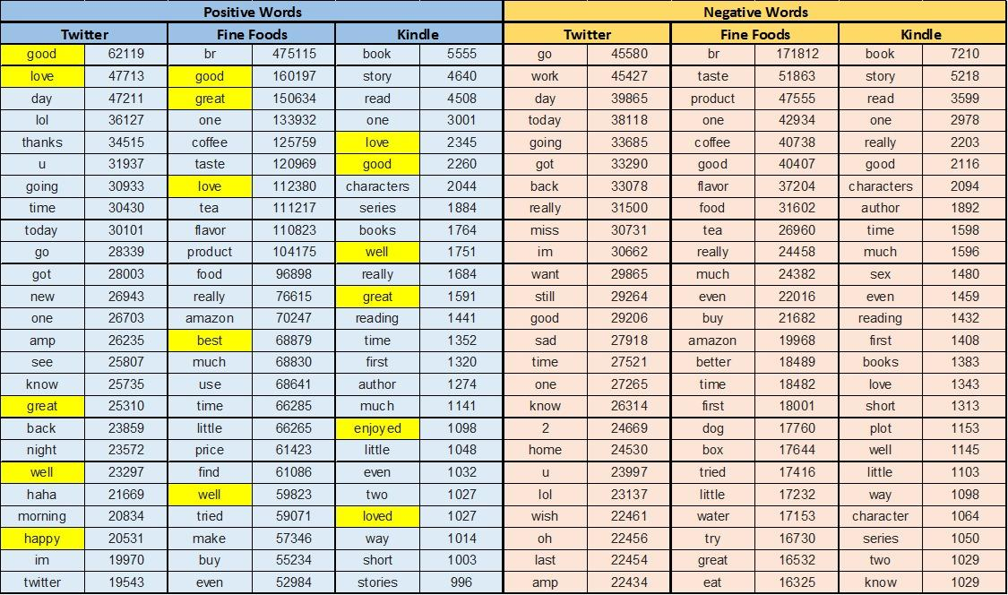
What could explain the accuracy differences of the LSTM-Models (2) Exploring the Data Sets and Models
Top 25 Words by number of times they appear in the Data Set divided by Sentiment
In order to explain the accuracy difference of the Models, we analyzed the most recurring words by sentiment, because those are likely to have a strong influence on how the Model predicts the sentiment
Striking is the number of different words expressing a similar meaning in the different data sets. One reason that could explain why the Kindle Model has a better ability to generalize could be that it contains a more refined set of words that express a positive sentiment.
Twitter model: “good, love, great, well, happy”
Fine food model: “good, great, love, best, well”
Kindle: “love, good, well ,great, enjoyed, loved”
A broader pool of words that express similar meaning could have a higher probability to capture the sentiment of unseen data

Slide 9
Conclusions of the findings What factors are likely to influence the ability to generalize?
The ratio of vocabulary size to training data set size could positively influence the ability to generalize
A broader pool of words that express a similar meaning could lead to a better ability to generalize
The training size has little to no influence on the accuracy on unseen test data
Contrary to what we assumed the Twitter Model did not inherit an ability to generalise by the broad context of the Data Set. This could indicate that the Context of the training data set is only relevant when it has an influence on the vocabulary size, which seems to be more relevant for the ability to generalise.

Slide 10
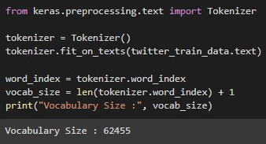
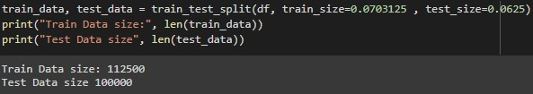
Recommendations for training a model How to choose the right data set
Check the vocabulary Size ratio to training data set size, this can be easily done by using a Tokenizer on the Data set, which will split the sentences into single words, which makes it able to measure the vocab size
Start with small training sizes and increase it until a point of diminishing returns are met, this can be done by using train test split, which allows one to set the size of the test and training set

Slide 11
Bibliography and Sources
McKinney, W. (2012). Python for data analysis: Data wrangling with Pandas, NumPy, and IPython. O'Reilly Media.
Müller, A. C., & Guido, S. (2016). Introduction to machine learning with Python. O'Reilly Media.
FH Dortmund, Data Science and Machine Learning, 2022, Class Notes and Code.
Datasets:
Twitter: https://www.kaggle.com/datasets/kazanova/sentiment140
Amazon Fine Food Reviews: https://www.kaggle.com/datasets/snap/amazon-fine-food-reviews
Amazon Kindle Book Reviews: https://www.kaggle.com/datasets/meetnagadia/amazon-kindle-book-review-for-sentiment-analysis
Datapreparation:
https://www.kaggle.com/code/arunrk7/nlp-beginner-text-classification-using-lstm

